Slide 1
Product sheet
Cell Culture Medium Product Sheet
FUJIFILM Wako Pure Chemical Corporation
27 Aug 2021

Slide 2
Product Line-up
~Culture media for vaccine production~
WakoVAC MDCK
WakoVAC PSFM-J1
WakoVAC Vero

Slide 3
What is WakoVAC MDCK?
FFWK Proprietary Media
Products developed under WakoVAC brand is taking a comprehensive approach to meet the key requirements for cell culture products in the field of life science.
Raw Materials
Components supply chain documented, scalable
Animal component-free
Hydrolysate (yeast-derived) contained
Industrial Applications
For bioproduction, scalable to commercial volumes
Available in both liquid and powder form
Performances
Best in class performance
Easy to use
*FFWK : FUJIFILM Wako Pure Chemical Corporation

Slide 4
What is WakoVAC MDCK?
Overview
WakoVAC MDCK has multiple prototypes
Designed to maximize MDCK cell growth, viability and productivity
Animal component-free formulation
Yeast-derived hydrolysate contained
GMP-compliant manufactured (non-GMP grade available for testing)
Target Markets and Customers
Bioprocessing companies developing biologics, especially vaccines
Research, process development, large-scale manufacturing/commercialization
Positioning
Formulations built for large-scale manufacturing and industrial vaccine applications
Achieve consistent, superior growth and sustained high-production capabilities
FFWK provides complete workflow support: Media Optimization Service to regulatory support at the time of IND/NDA

Slide 5
What is WakoVAC MDCK?
Product Specification
 | PN TBD
Form | Powder (and liquid upon request)
Packaging | Flexible
Shelf-life | 12 months+ (powder, ongoing)
Storage | 2-10˚C*, protect from light
*Attached supplement (vial); under -20℃
Intended Use: Research and further manufacturing
Product Features
Animal component-free
Multiple prototypes available for testing
The latest prototype shows an improved virus yield approximately 1.5 times higher than Medium B, commercially available serum-free medium from a competitor
Designed and optimized for small to large-scale vaccine production
Compatible with microcarrier
Adaptation not typically required
Scalable, adaptable system to support commercialization
GMP-compliant manufactured

Slide 6
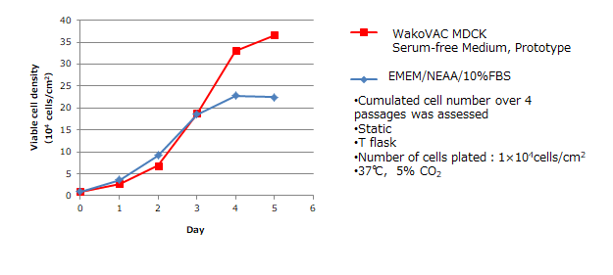
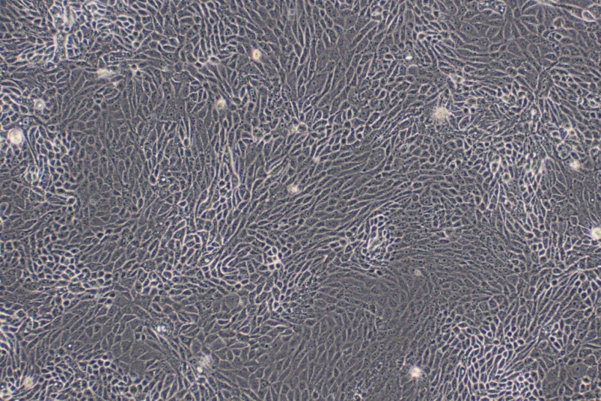
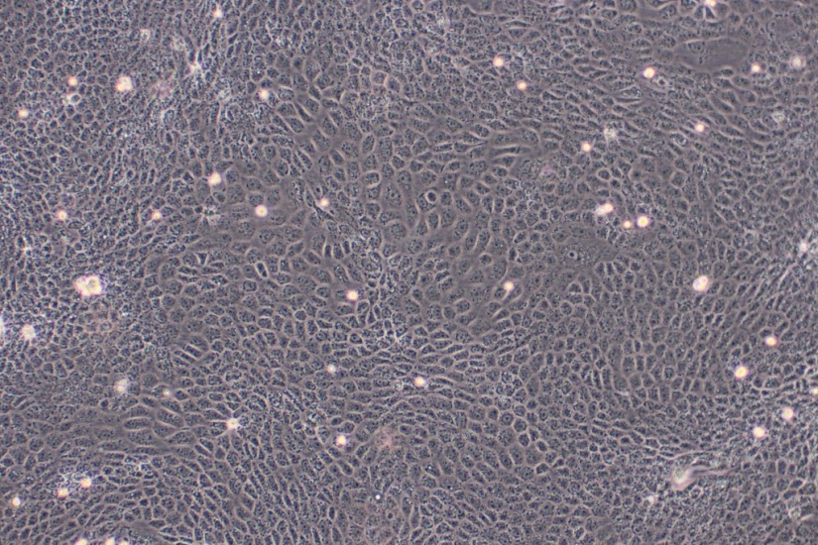
Outperforms commercially available serum-containing option
WakoVAC MDCK
Serum-free Medium,
Prototype A（Day4）
A
EMEM/NEAA/
10%FBS（Day4）
Equal to or higher yields of influenza virus than commercially available serum-containing option
WakoVAC MDCK
Serum-free Medium, Prototype A
Medium B, Competitor’s
Influenza A virus (H1N1)
Static
T flask
37℃, 5%CO₂
Number of viral inoculated cells
Wako：25.8×10⁴ cells/cm²
Medium B：21.2×10⁴ cells/cm²

Slide 7
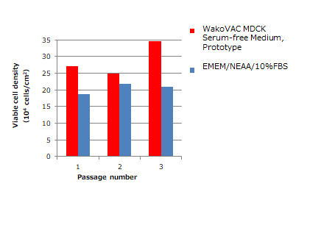
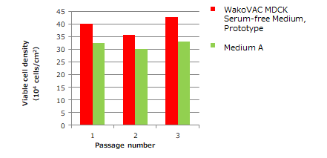
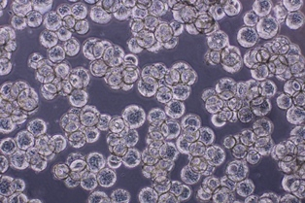
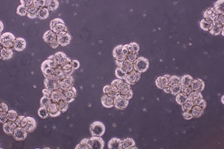
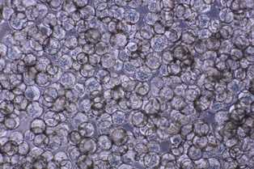
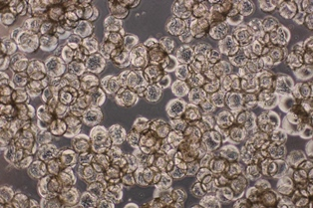
Adaptation not necessarily required
Switch from a commercially available serum-free medium
Switch from a serum-containing medium
A
A
C
MDCK cell
Serum-free medium
Static
T flask
37℃, 5% CO₂
Number of cells plated:
1×10⁴ cells/cm²
Culturing duration: 4 days
MDCK cell
Serum-free medium
Static
T flask
37℃,5% CO₂
Number of cells plated:
1×10⁴ cells/cm²
Culturing duration: 4 days
Compatible with microcarrier
MDCK cell with WakoVAC MDCK Prototype A
Microcarrier
@day3 and day4
Cell detachment↓
Cell aggregation↓
MDCK cell with Medium D, Competitor’s
Microcarrier
@day3 and day4
Cell detachment↑
Cell aggregation↑

Slide 8
What is WakoVAC PSFM-J1?
In-licensed media
Formulated for insect cell expansion. Even being made with the same formulation, WakoVAC PSFM-J1 manufactured in FFWK outperforms the same media manufactured by a competitor due to quality and strictly-controlled raw materials.
Raw Materials
Components supply chain documented, scalable
Fish-oil (cGMP, virus-inactivated) and hydrolysate (yeast-derived) contained
Industrial Applications
For vaccine production, scalable to commercial volumes
Available in both liquid and powder form
Performances
Best in class performance
Easy to use

Slide 9
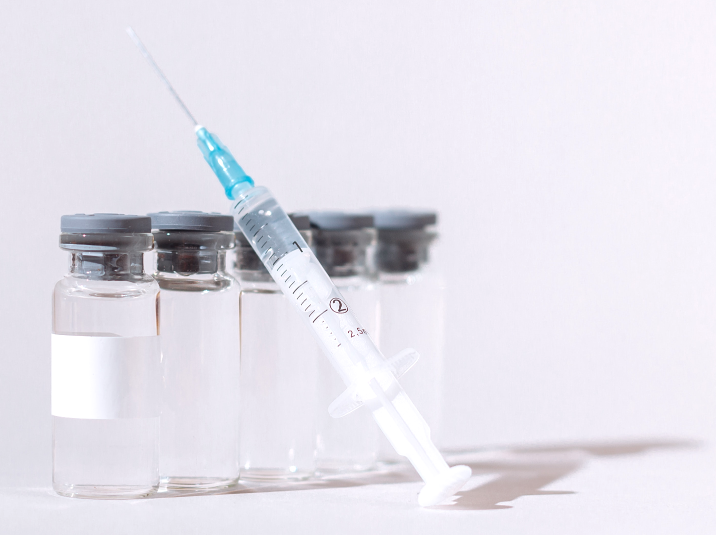
What is WakoVAC PSFM-J1?
Overview
Supports a wide range of insect cells: Hi5, Sf9, Sf21
Designed to maximize insect cell growth, viability and productivity
GMP-compliant manufactured
FFWK provides regulatory support to ensure the compliance required by each country’s pharmaceutical authority
Target Markets and Customers
Bioprocessing companies developing biologics, especially vaccines
Research, process development, large-scale manufacturing/commercialization
Positioning
Formulations built for large-scale manufacturing and industrial vaccine applications
Achieve consistent, superior growth and sustained high-production capabilities
FFWK provides complete workflow support: Media Optimization Service
Product Specification
Intended Use: Research and
further manufacturing
 | PN 160-25851 | PN TBD
Form | Liquid | Powder
Packaging | 1L | 8kg (customize upon request)
Shelf-life | 1 year from the date of MFG | 2 years from the date of MFG
Storage | 2-10˚C, protect from light

Slide 10
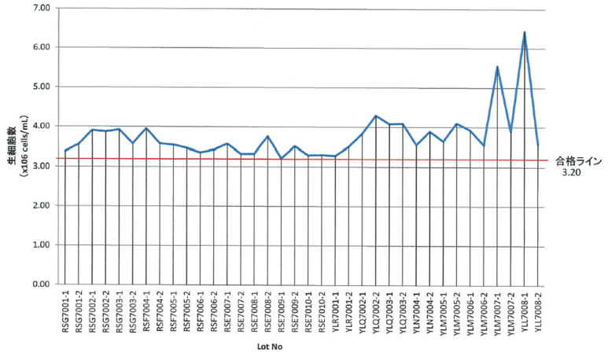
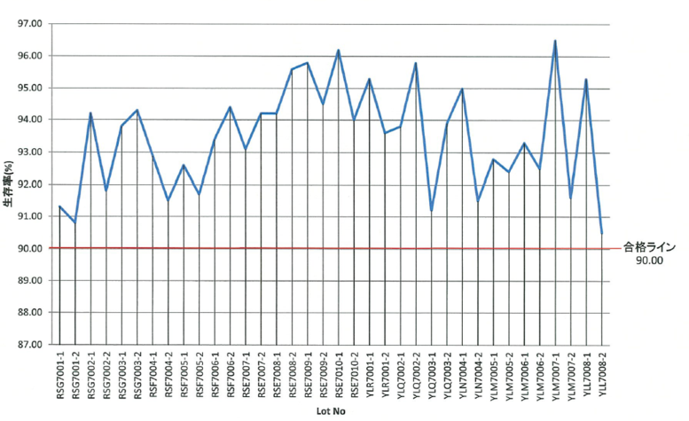
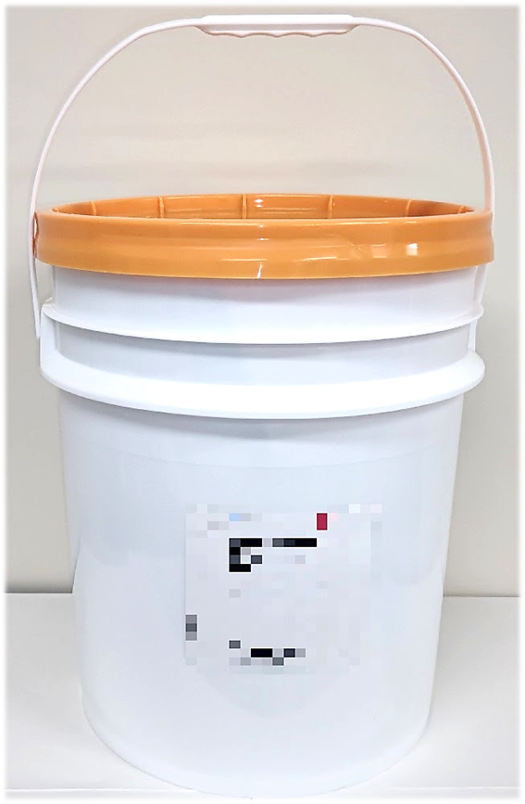
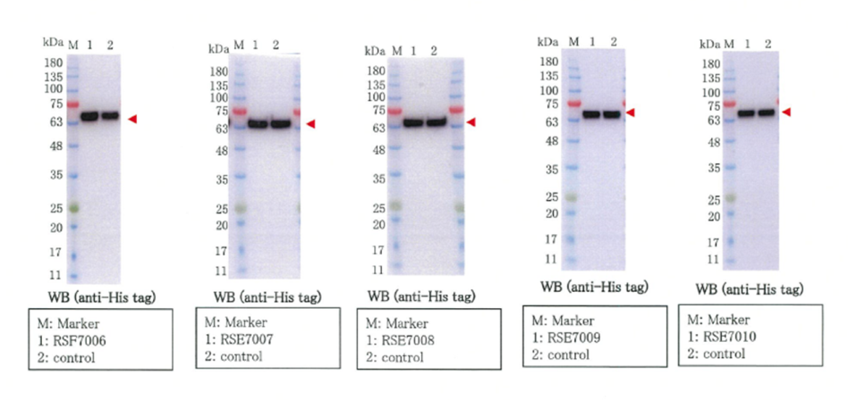
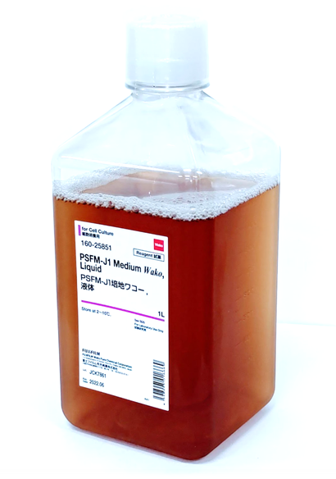
What is WakoVAC PSFM-J1?
Product Features
Supports wide range of insect cells
Flexible packaging
Fish-oil (cGMP) and yeast-derived hydrolysate contained
CoA available. Cell growth, cell viability and protein expression data can be included upon request
Wako Internal
Specification
Viable Cell Count
Viability(%)
Acceptance line
Acceptance line
Cell Growth
Cell Viability
Retain target protein expression over multiple lots

Slide 11
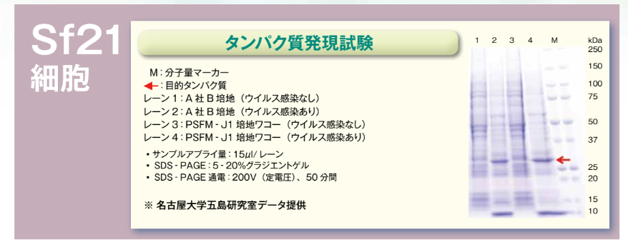
Other information
Assure lot-to-lot consistency
Fine protein expression also in Sf9, Sf21 and Hi5
L-Glutamine does not need to be supplemented
Comparative landscape
Product Description | Supplier | SF | ACF | PF | CD | GMP | Yeast Extract | Cell Type | Shelf-life | Storage | Size | Packaging
Medium X | Competitor | + | + | - | - | + | Low | Sf9, Sf21 | 12 mo | 2-8℃ | 1L | 5L (Customize upon request)
WakoVAC PSFM-J1 | FFWK | + | Fish-oil | + | - | + | Medium | Hi5, Sf9,Sf21 | 12 mo | 2-10℃ | 1L | 10L and 20L Powder available
Retains target expression with Sf21
Protein Expression Testing
Cells
M : Molecular weight size marker
➔：Target protein
Lane 1：Medium A (Pre-viral inoculation)
Lane 2：Medium A (Post-viral inoculation)
Lane 3：PSFM-J1 (Pre-viral inoculation)
Lane 4：PSFM-J1 (Post-viral inoculation)
・The amount of samples being used: 15 μL/Lane
・ SDS-PAGE: 5-20% gradient gel, 200v constant
・ Voltage for 50 minutes
※Data provided by Goshima Lab from Nagoya University

Slide 12
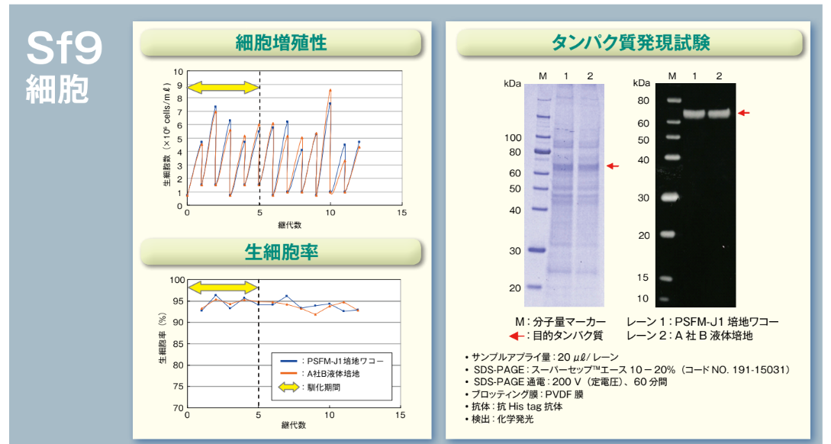
Retains robust cell growth, viability and target expression with Sf9
Cell Growth
Protein Expression Testing
Cells
Viable Cell Count
passage
Cell Viability
M : Molecular weight size marker
➔：Target protein
Lane 1: WakoVAC PSFM-J1
Lane 2: Medium B Control
Viability(%)
・The volume of samples being used: 20 μL/Lane
・SDS-PAGE: SuperSep (TM) Ace 10-20% (Product code: 191-15031), 200v constant voltage for 60 minutes
・Western blotting: PVDF membrane
・Antibody: Anti-his tag antibody
※Data provided by Goshima Lab from Nagoya University
PSFM-J1 Wako
Medium B Control
Adaptation period
passage

Slide 13
Retains robust cell growth, viability and target expression with Hi5
Cells
Cell Growth
Protein Expression Testing
Expressed more protein than the control (competitor’s).
Viable Cell Count
Equal to or higher yields of influenza virus than commercially available serum-containing option
passage
Cell Viability
M : Molecular weight size marker
➔：Target protein
Lane 1: WakoVAC PSFM-J1
Lane 2: WakoVAC PSFM-J1 + L-Glutamine
Lane 3: Medium C Control + L-Glutamine
Viability(%)
・The volume of samples being used: 20 μL/Lane
・SDS-PAGE: SuperSep (TM) Ace 10-20% (Product code: 191-15031), 200v constant voltage for 60 minutes
・Western blotting: PVDF membrane
・Antibody: Anti-his tag antibody
＊Data provided by Mirai-Kougaku
passage
PSFM-J1 Wako
PSFM-J1 Wako +L-glutamine
Medium C Control +L-glutamine
Adaptation

Slide 14
What is WakoVAC Vero?
FFWK Proprietary Media
Products developed under WakoVAC brand is taking a comprehensive approach to meet the key requirements for cell culture products in the field of life science.
Raw Materials
Components supply chain documented, scalable
Animal component-free
Hydrolysate (yeast-derived) contained
Industrial Applications
For bioproduction, scalable to commercial volumes
Available in both liquid and powder form
Performances
Best in class performance
Easy to use

Slide 15
What is WakoVAC Vero?
Overview
WakoVAC Vero has multiple prototypes
Designed to maximize Vero cell growth, viability and productivity
Animal component-free formulation
Yeast-derived hydrolysate contained
GMP-compliant manufactured (non-GMP grade available for testing)
Target Markets and Customers
Bioprocessing groups developing vaccine biologics
Research, process development, large-scale manufacturing/commercialization
Positioning
Formulations built for large-scale manufacturing and industrial vaccine applications
Achieve consistent, superior growth and sustained high-production capabilities
FFWK provides complete workflow support: Media Optimization Service to regulatory support at the time of IND/NDA

Slide 16
What is WakoVAC Vero?
Product Specification
 | PN TBD
Form | Powder and/or Liquid (TBD)
Packaging | Flexible
Shelf-life | TBD
Storage | 2-10˚C, protect from light
Intended Use: Research and further manufacturing
Product Features
Animal component-free
Multiple prototypes available for testing
Designed and optimized for small to large-scale vaccine production
Compatible with microcarrier
Adaptation not typically required
Scalable, adaptable system to support for commercialization
GMP-compliant manufactured
Formulation will be established for the best performance with your cells
Multiple companies worldwide have been testing out our prototypes

Slide 17
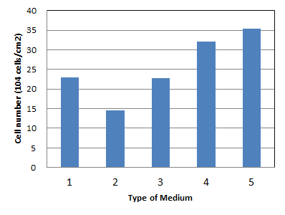
Shows better cell proliferation
Plate：Corning 12 well Plate (Corning, #3513)
Cell type：Vero cell
Number of seeded cells：30,000 cells/well
Condition：37℃, 5%CO₂
Culture period：5 days
Medium: 2.0mL
1: EMEM/5%FBS
2: DMEM/5%FBS
3: SFM from a competitor
4: WakoVAC Vero prototype A
5: WakoVAC Vero prototype B

